Slide 1


Slide 2
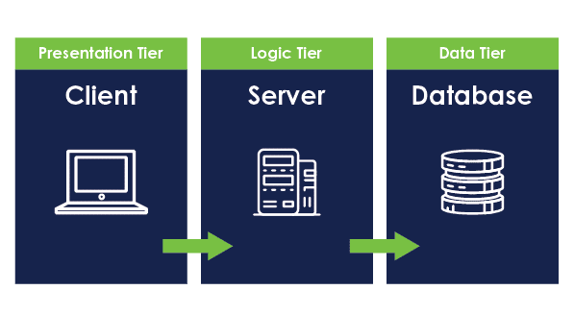
How Web Works

Slide 3
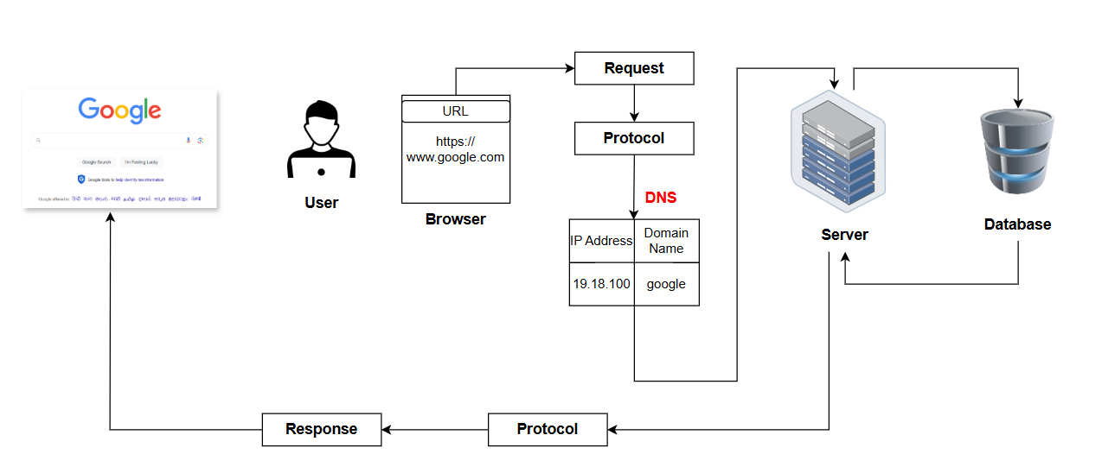
How Web Works

Slide 4
Browser: Browser is a client side application which is used to send requests and get back the responses from the server.
URL: URL stands for uniform resource locator. When we search for anything in the browser, It will generate an URL. Ex: https://www.instagram.com.
DNS: DNS stands for Domain Name Server It is responsible for converting URLs into IP addresses.
Server: It is the place where all the websites are hoisted. Ip address of all data were stored here.
Http: Https: Http stands for HyperText Transfer Protocol.
It transfers the information as plain text. Https stands for HyperText Transfer Protocol Secure. It transfers the information in encrypted format

Slide 5

Web & Web Page
Web is a collection of information i.e in the form of text/webpage/Websites.
Web page is a simple document written in html / Saved with .html extension.

Slide 6
Types of Web Page
Static Web Pages
Dynamic Web Pages

Slide 7
Static vs Dynamic Web Pages
Static page | Dynamic page
Content remains same | Content differs to each individuals based on their Prefrence.
User interaction is comparatively less | User interaction is more which can reflects on their network
Less usage of database interactivity | Database management is necessary

Slide 8
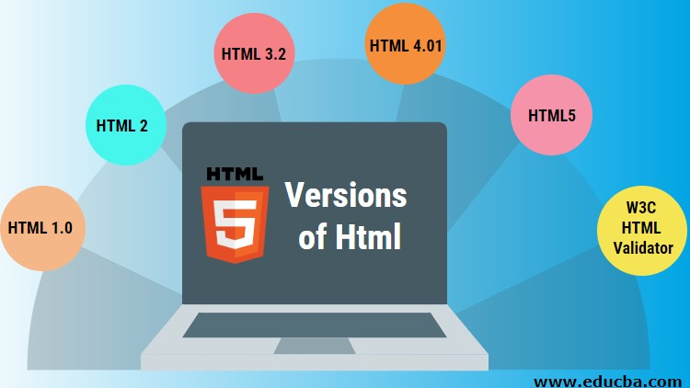

History of HTML
Tim Berners Lee
HTML is invented by Tim Berners lee in 1991 i.e HTML version 1.0 , but it was releases for public in 1993 .

Slide 9
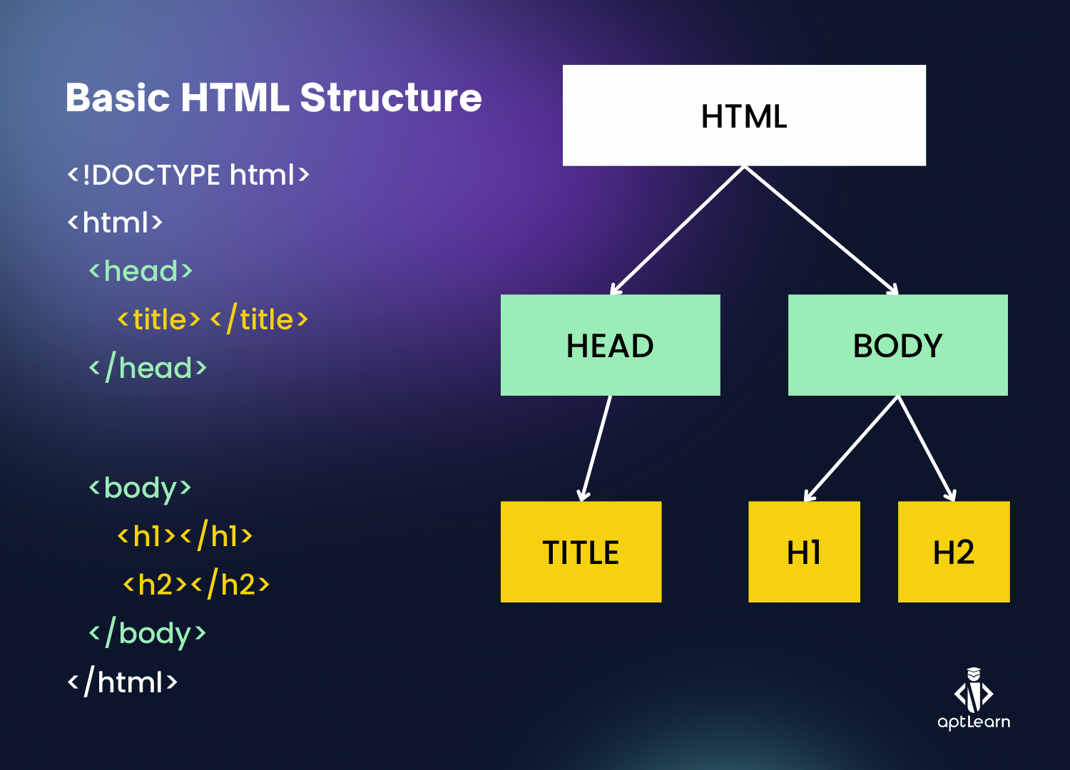
Structure of HTML

Slide 10
Tags in Html
Tags are predefined keywords which are enclosed in Angular braces <>.
The task of each tag has been declared already.
Types of tags in html
1.Paired Tags
A tag which is required of both opening tag and closing tag .
Eg - <p> </p> , <div></div>.
2. Unpaired Tags
A tag which is not required of both opening tag and closing tag.
Eg - <hr> , <br>

Slide 11
Elements in HTML
An element is a combination of opening tag +content + closing tag
We have three types of elements
Block level element - It will take the entire viewport width. It allows height and width. Eg - div
Inline level element - It will take the content width only. It will not allow height and width. Eg - span
Inline block level element -It will take the content width and it will allow the height and width. Eg - img

Slide 12
Attributes in HTML
Attributes are special keywords which are provided in the opening tag of the element , it will provide additional information about element .
id - uniquely identify an element. One element should have one id only
class - used to group similar elements. One element can have multiple classes.
style - used to give inline css
title - used to provide the tooltip, which is the extra information to the user, once he hovers the cursor over the element

Slide 13
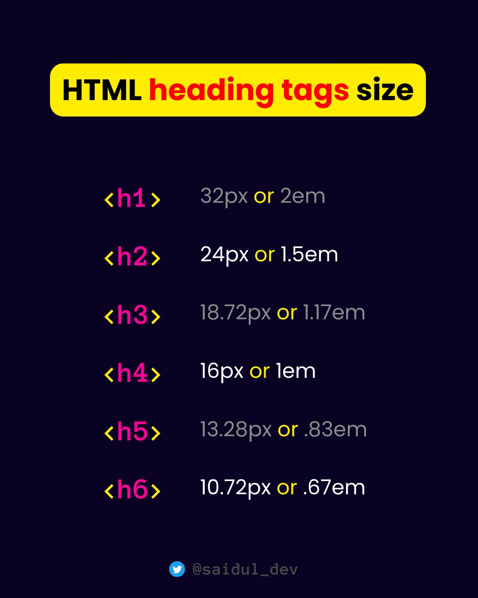
Heading Tags
Heading tags are basically used to provide title or subtitle to the content in the webpage these all are paired tags.
We have set of heading tags from h1 to h6.
H1 is the highest in font size &
H6 is the least in font size .

Slide 14
Formatting Tags are used to display the content in different formats.
● b → It will display the content in bold format.
● i → It will display the content in Italic format.
● u → It will provide an underline to the content.
● mark → It will highlight the content with yellow background color.

Slide 15
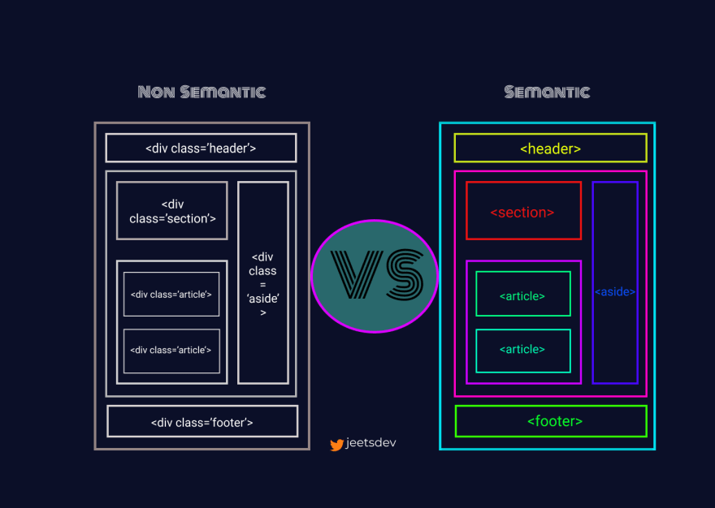
Semantic tags
The tags itself define their purpose.
<header>
<article>
<main>
<nav>
<section>
<aside>
<footer>

Slide 16
Lists in HTML
HTML Lists allows to group the items together. HTML lists were classified into 2 ways.
Ordered list
Group of items in a sequential format, also known as number list.
Tags – ol , li
Attributes – type (format of sequence – 1,a,A,I,i), start (starting position - number), reversed
Unordered list
Display a set of related items with special symbols, also known as bullet list
Tags – ul,li
Attributes – type (format of sequence – disc,square,circle,none)

Slide 17
Image Tag
The <img> tag is used to embed an image in an HTML page.
The <img> tag has two main attributes:
src - Specifies the path to the image .
alt - Specifies an alternate text for the image, if the image for some reason cannot be displayed .
height & width these attribute is used to provide height & width for an image .

Slide 18
Anchor tag and hyperLink
Anchor tag helps us to navigate from one web page to another webpage , and within the same page also . By using anchor tags, we can create hyperlinks in a webpage .
Whatever content you place inside an anchor (<a>) tag becomes a clickable hyperlink. This content can be text, images, or even other HTML elements.
Hyperlink is a clickable link in a digital document or webpage that takes you to another location.
An unvisited link is underlined and blue.
A visited link is underlined and purple.
An active link is underlined and red.

Slide 19
Attributes of Anchor tag
href Hyperlink refrence
Values (path , # , “ ” , mailto:example@example.com , tel:9897XXXXX)
Target The target attribute in an anchor (<a>) tag specifies where to open the linked document or webpage when the hyperlink is clicked.
Values (_blank , _self )

Slide 20
Tables in HTML
HTML Tables allow us to store the data in the form of rows and columns
Tags -
table - table creation
th – table heading
tr – table row
td – table data
thead – combine all header cell together
tbody - combine all body cell together
tfoot - combine all footer cell together
caption – title to your table
Attributes
border – to get border to table
cellspacing – space between cells
cellpadding – space between content and border
rowspan – merge cells over rows
colspan – merge cells over columns

Slide 21
Audio tag
The <audio> tag is used to embed audio content in a document, such as a movie clip or other audio streams .
Attributes :
Src - Specifies the URL of the audio file .
controls- Specifies that audio controls should be displayed (such as a play/pause button etc)..

Slide 22
Video tag
The <video> tag is used to embed video content in a document, such as a movie clip or other video streams .
Attributes :
Src - Specifies the URL of the video file .
controls- Specifies that video controls should be displayed (such as a play/pause button etc)..

Slide 23
What is Form ?
"HTML forms are used to collect input or data from users and send it to a server for further processing."

Slide 24
What are Form Elements ?
Form elements are the components within an HTML form that allow users to enter and submit data.
<input> tag is used to create a field where users can enter data, like text, numbers, or passwords, on a web page
<label> tag in HTML is used to define a caption or name for an input element It helps users to understand what information they should enter.
<Select> tag in HTML is used to create a dropdown menu where users can choose one or more options from a list.
<textarea> tag in HTML is used to create a large text box where users can enter multiple lines of text, like for writing a comment or message.

Slide 25
What are Form Elements ?
<button> tag in HTML creates a clickable button on a web page. When clicked, it can perform actions like submitting a form or triggering a script.
<fieldset> tag in HTML is used to group related elements, like input fields, within a form. It helps organize the form and often includes a caption using the <legend> tag.
<legend> tag in HTML is used to provide a title or caption for a <fieldset>. It helps describe what the grouped form elements are about..
<option> tag in HTML is used to provide the select options in the drop down list .

Slide 26
What is HTML Input and its types ?
"HTML <input> is an unpaired tag used to accept different types of input from a user. The type of input is specified by the type attribute, which can have various values such as text, email, password, date, and more."
<input type="button">
<input type="checkbox">
<input type="date">
<input type="email">
<input type="file">
<input type="number">
<input type="password">
<input type="radio">
<input type="submit">
<input type=“text">

Slide 27
Attributes inside form Tag.
HTML <input> elements have several attributes that define their behavior and appearance. Some common attributes include:
type: Specifies the type of input (e.g., text, email, password).
name: Defines the name of the input field, which is used when data is submitted.
value: Specifies the initial value of the input field.
placeholder: Provides a short hint that describes the expected value of the input.
required: Indicates that the input field must be filled out before submitting the form.

Slide 28
Attributes inside Form Tag.
disabled: Disables the input field, making it unmodifiable and non-submittable.
min and max: Define the minimum and maximum values for number, date inputs.
checked: it specifies that an <input> element should be pre-selected (checked) when the page loads. Can be used with radio and checkbox.
id , for : Used to link the input field with the label. Need to provide the same values.

Slide 29
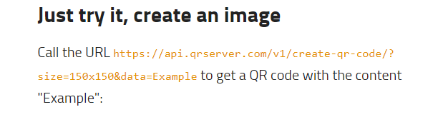
QR code
How to generate QR code
Step 1- Search in google qr code api .
Step 2- click on goqr.me .
Step 3- copy the whole link call the url and paste it in img tag src=“ ” .
Step 4- then paste your target link , on which website you want to navigate .

Slide 30

Thank you

